Slide 1
Polymorphism

Slide 2
Outline
In this lesson, we will:
Introduce the concept of polymorphism
Look at its application in:
The Shape class to determine whether or not a point is in the image
The Account class to determine the appropriate deposit(…) and withdrawal(…) member function is called
The std::exception class to override the what() member function
Discuss issues surrounding polymorphism

Slide 3
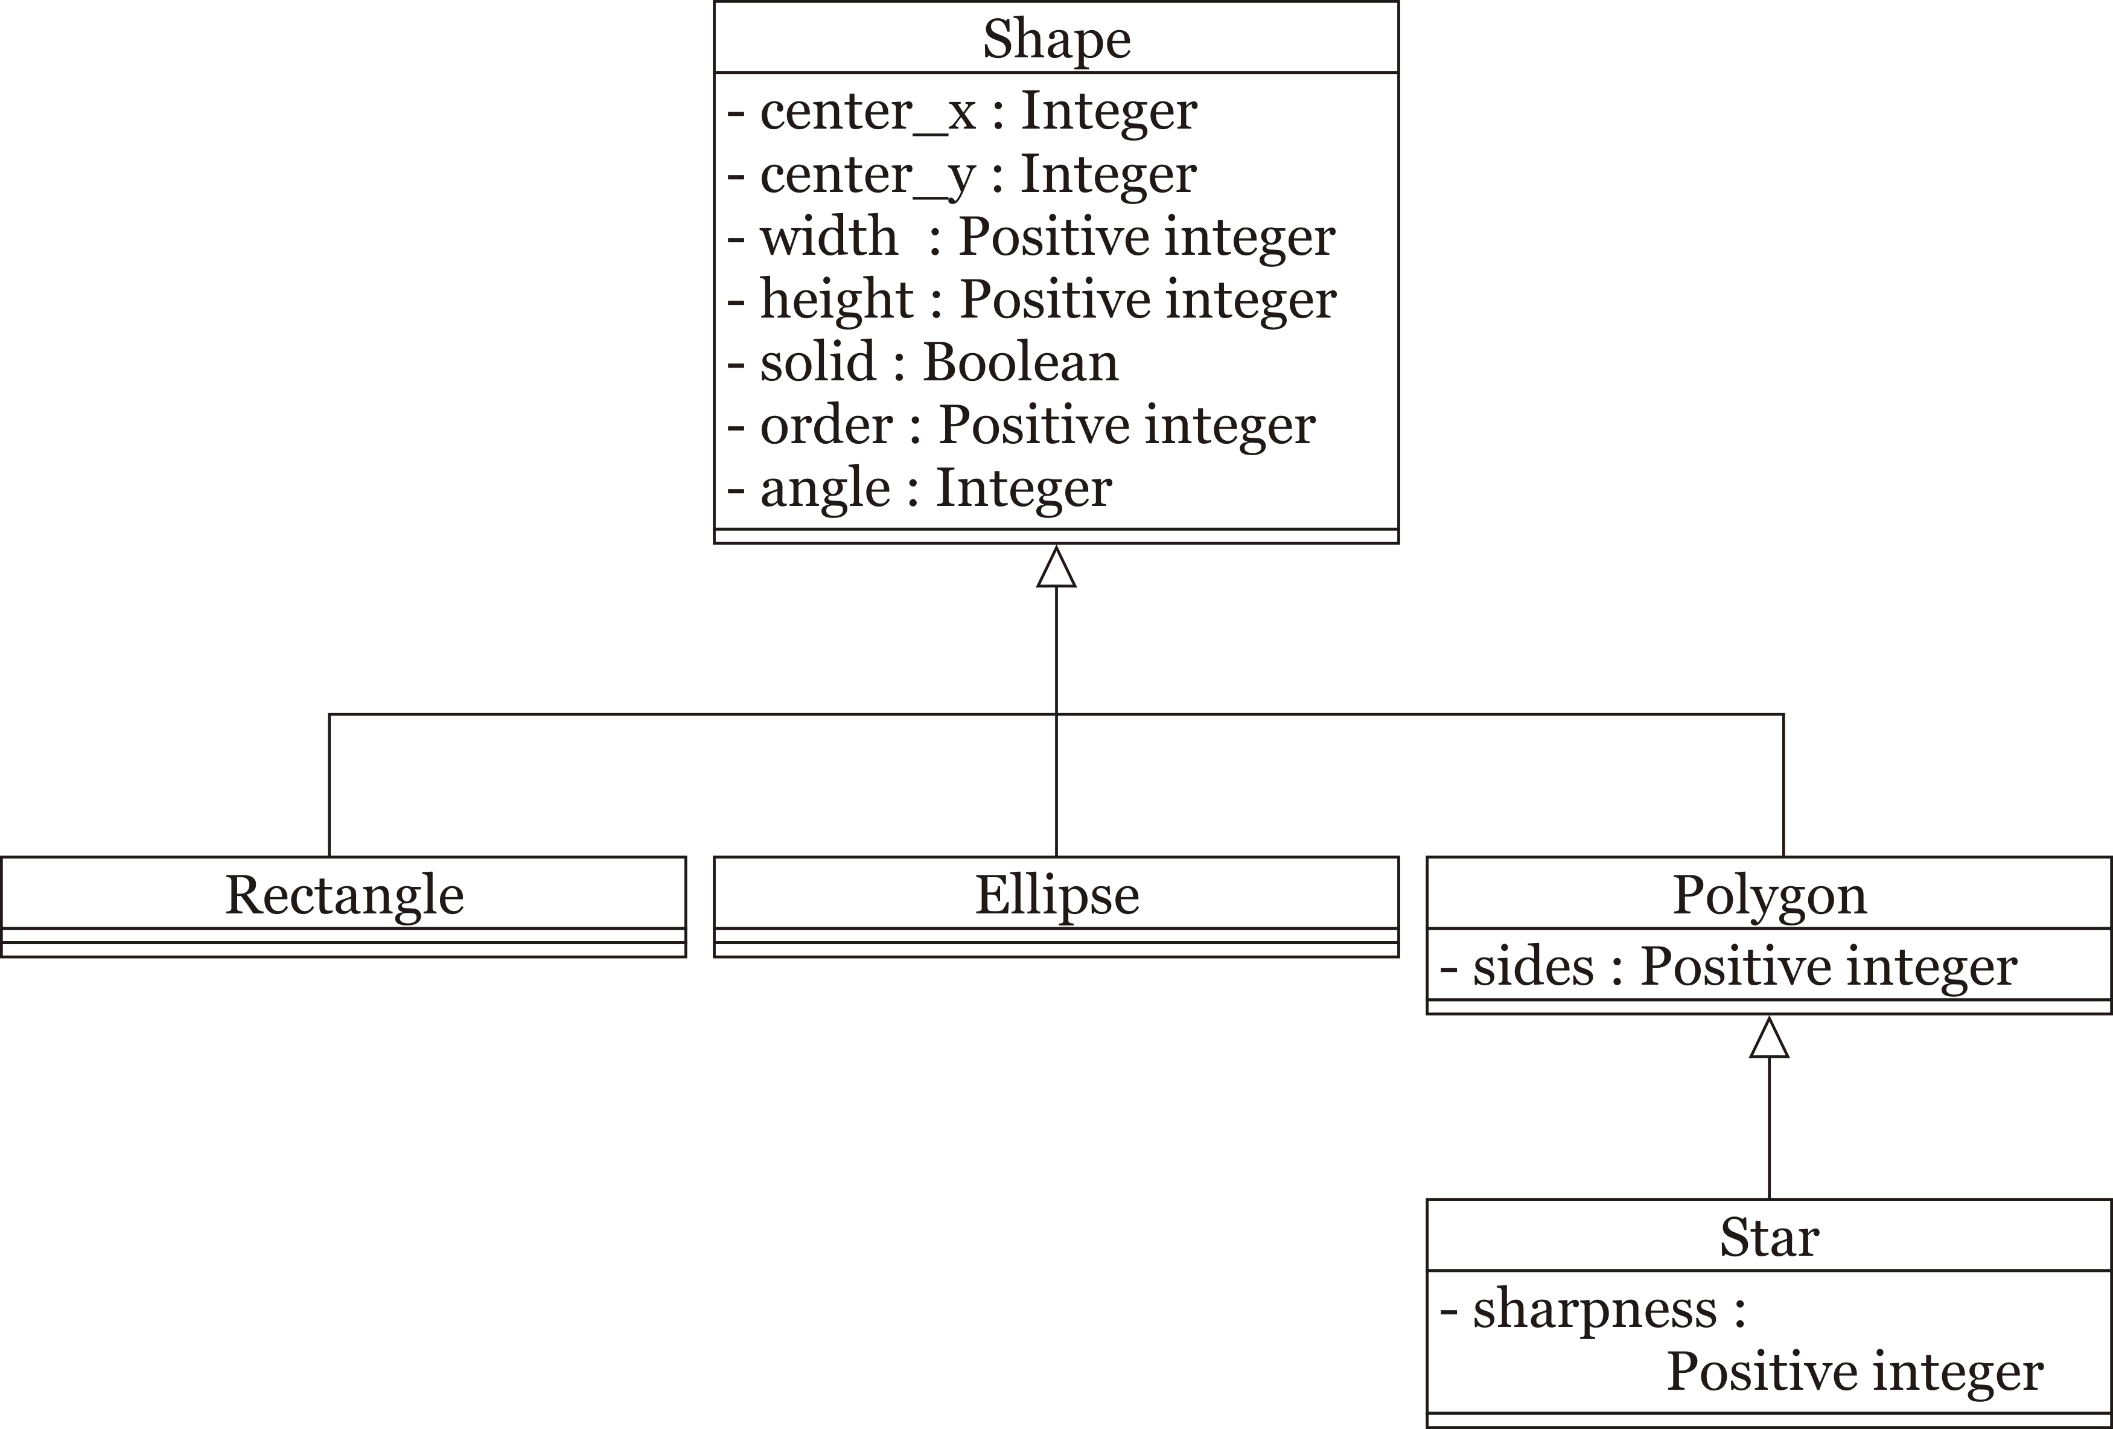
Member functions
We have looked at the Shape class:

Slide 4
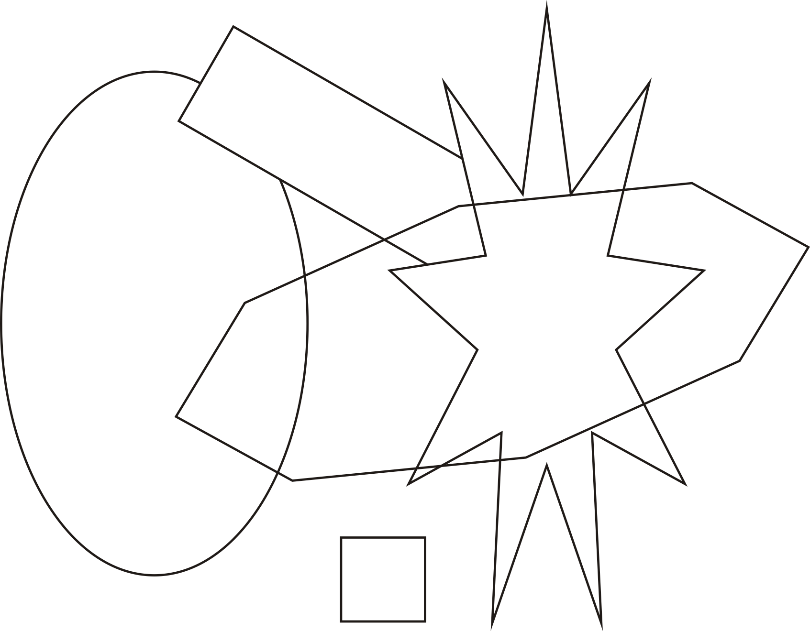
Member functions
Every shape object represents something in the graphic:

Slide 5
Member functions
One question you may want to ask is:
Does one shape sit at a point (x, y)?
The return value will be:
-1 if no
0 if it is black (the outline)
1 if it is white (fill, if applicable)

Slide 6
Member functions
This function will have to be different for each shape
Rectangles are the easiest
Ellipses are slightly more difficult
Polygons are more complex
Stars make polygons look easy

Slide 7
Member functions
Thus, each function can have such a public member function:
class Rectangle {
public:
int covers( int x, int y ); // (um, um)
// other public member functions
private:
// private member
// variables and functions
};

Slide 8
Member functions
For example:
int Rectangle::covers( int m, int n ) {
// Unrotate the point
double x{m - center_x};
double y{n - center_y};
double theta{angle/3600.0*M_PI};
double rx{ x*std::cos(theta) + y*std::sin(theta)};
double ry{-x*std::sin(theta) + y*std::cos(theta)};
// If it is outside the rectangle, return -1
// - the border is width 10 um across the edge
if ( (rx < -width/2.0 – 5.0) || (rx > width/2.0 + 5.0)
|| (ry < -height/2.0 – 5.0) || (ry > height/2.0 + 5.0) ) {
return -1;
}
// If it is on the border (10 um wide), return black (0)
if ( ((rx >= -width/2.0 - 5.0) || (rx <= -width/2.0 + 5.0))
|| ((rx >= width/2.0 - 5.0) || (rx <= width/2.0 + 5.0))
|| ((ry >= -height/2.0 - 5.0) || (ry <= -height/2.0 + 5.0))
|| ((ry >= height/2.0 - 5.0) || (ry <= height/2.0 + 5.0)) ) {
return 0;
}
// Otherwise, return white (1) if it filled, otherwise -1
return filled ? 1 : -1;
}

Slide 9
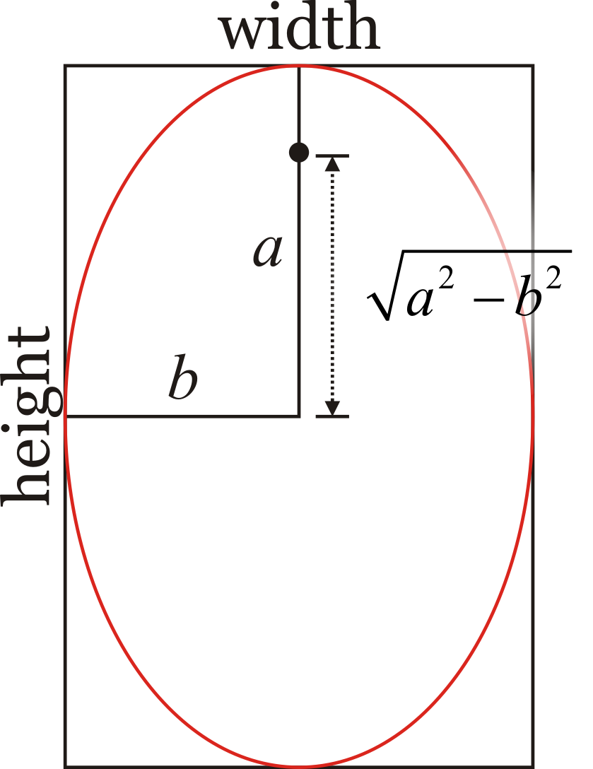
Member functions
For the ellipse:
The height and width define the major and minor axes
From this, the foci can be determined
It gets more difficult for polygons and stars

Slide 10
Member functions
Now, if you had a pointer or reference to a shape
It may be a rectangle, ellipse, polygon, star, etc.
Which member function should be called?
Can you even call such a member function—it isn’t defined in Shape
After all, a “shape” cannot have such a member function
A generic “shape” does not have a manifestation on the screen

Slide 11
Member functions
Solution: let the compiler know that it must search for the definition
class Shape {
public:
virtual int covers( int x, int y ) const = 0; // (um, um)
// Other public declarations
private:
// Other private declarations
};
class Rectangle {
public:
virtual int covers( int x, int y ) const;
// Other public declarations
private:
// Other private declarations
};
int Rectangle::covers( int x, int y ) const {
// Implementation here...
}
A pure virtual member function (= 0) indicates this
function is not meant to be defined for the Shape class

Slide 12
Abstract classes
Any class with at least one pure virtual member function can never be instantiated
The compiler simply will not allow it
You cannot create an instance of the Shape class because there is no definition of the covers(…) member function
All derived classes that are not also abstract must define the covers(…) member function, including:
Ellipses
Polygons
Stars
A class derived from a non-abstract class is never abstract unless new pure virtual member functions are introduced

Slide 13
Member functions
Now, given a reference or pointer to a shape:
Shape &obj{...}; // Reference to some shape
Shape *p_obj{...}; // Pointer to some shape
calling covers(…) will call the appropriate member function

Slide 14
Accounts
Suppose you have a reference or pointer to an account:
Account &obj{...}; // Reference to some account
Account *p_obj{...}; // Pointer to some account
The behavior of both deposit(…) and withdrawal(…) differs depending on the account
The default behavior is not acceptable in most cases
To ensure the appropriate member function is called:
The member functions are declared virtual
If a class does not define a virtual function, the definition in the base class is called
If it is not defined there, the definition in that class’s base class is called, and so on…

Slide 15
Exceptions
Suppose you extend the exception class and override the member function what():
It is declared virtual in the std::exception base class
#include <stdexcept>
#include <string>
class Coded_exception;
class Coded_exception : public std::logic_error {
public:
Coded_exception( std::string what_arg, int code );
virtual char const *what() const noexcept;
int code() const;
private:
int error_code;
};
The noexcept indicates to the compiler the member function does not throw an exception

Slide 16
Exceptions
Suppose you extend the exception class and override the member function what():
Coded_exception::Coded_exception( std::string what_arg, int code ):
std::logic_error{what_arg},
error_code( code ) {
// Empty constructor body
}
char const *Coded_exception::what() const noexcept {
return (
std::logic_error::what() // Call "what()" from the base class
+ std::string{" ("}
+ std::to_string( error_code )
+ ")"
).c_str(); // Return a C-style string
}
int Coded_exception::code() const {
return error_code;
}

Slide 17
Exceptions
We can now use this class:
int main() {
try {
throw Coded_exception( "This is a test", 5 );
} catch ( std::logic_error &e ) {
std::cout << e.what() << std::endl;
}
return 0;
}
Output:
This is a test (5)
char const *Coded_exception::what() const noexcept {
return (
std::logic_error::what() // Call "what()" from the base class
+ std::string{" ("}
+ std::to_string( error_code )
+ ")"
).c_str(); // Return a C-style string
}

Slide 18
Implementing polymorphism
For polymorphism to work, it is necessary that:
The graph describing the relationship between derived and base classes is encoded and stored with the executable
Every time a virtual member function is called, it is necessary to determine which member function to call
This is potentially computationally expensive

Slide 19
Polymorphism in other languages
C++ requires the virtual keyword to use polymorphism
However, most object-oriented programming languages implement polymorphism by default
There is no alternative behavior
The C++ programming language balances speed versus versatility
If you are not using polymorphism, the compiler can simplify the executable
There is no need to ever refer to the class hierarchy

Slide 20
Summary
Following this lesson, you now
Understand the idea of polymorphism
Are aware of the virtual keyword
Know how to call the appropriate function for the appropriate class

Slide 21
References
[1] No references?

Slide 22



Colophon
These slides were prepared using the Georgia typeface. Mathematical equations use Times New Roman, and source code is presented using Consolas.
The photographs of lilacs in bloom appearing on the title slide and accenting the top of each other slide were taken at the Royal Botanical Gardens on May 27, 2018 by Douglas Wilhelm Harder. Please see
https://www.rbg.ca/
for more information.

Slide 23
Disclaimer
These slides are provided for the ece 150 Fundamentals of Programming course taught at the University of Waterloo. The material in it reflects the authors’ best judgment in light of the information available to them at the time of preparation. Any reliance on these course slides by any party for any other purpose are the responsibility of such parties. The authors accept no responsibility for damages, if any, suffered by any party as a result of decisions made or actions based on these course slides for any other purpose than that for which it was intended.

